Slide 1



PEILab Group Meeting
Leader: Zicong Hong
Team Member: Jian Lin, Haodong Wang, Qianli Liu, Kaibin Guo, Junjie Liu

Slide 2
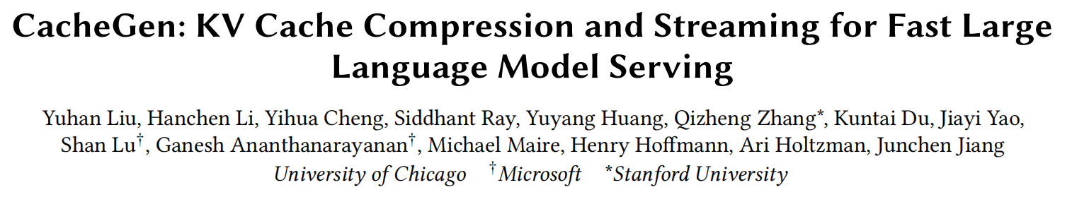
CacheGen
SIGCCOM’24

Slide 3
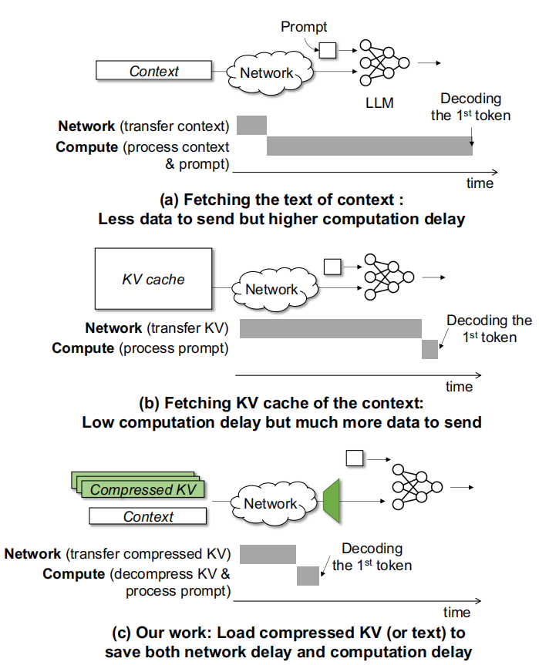
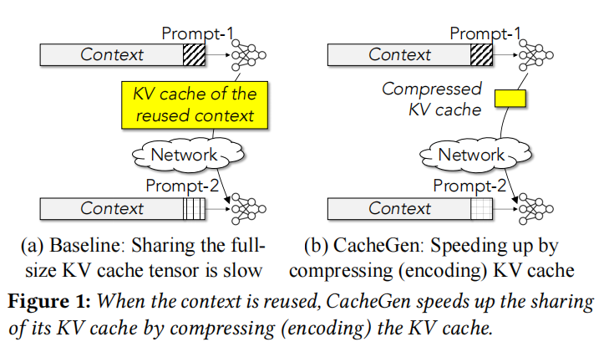
CacheGen

Slide 4
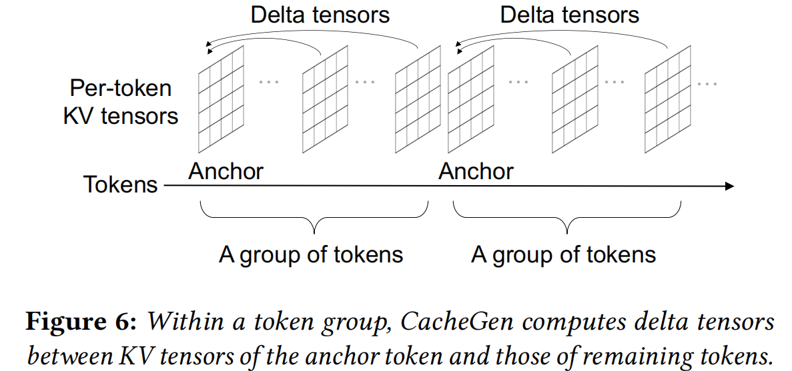
CacheGen

Slide 5
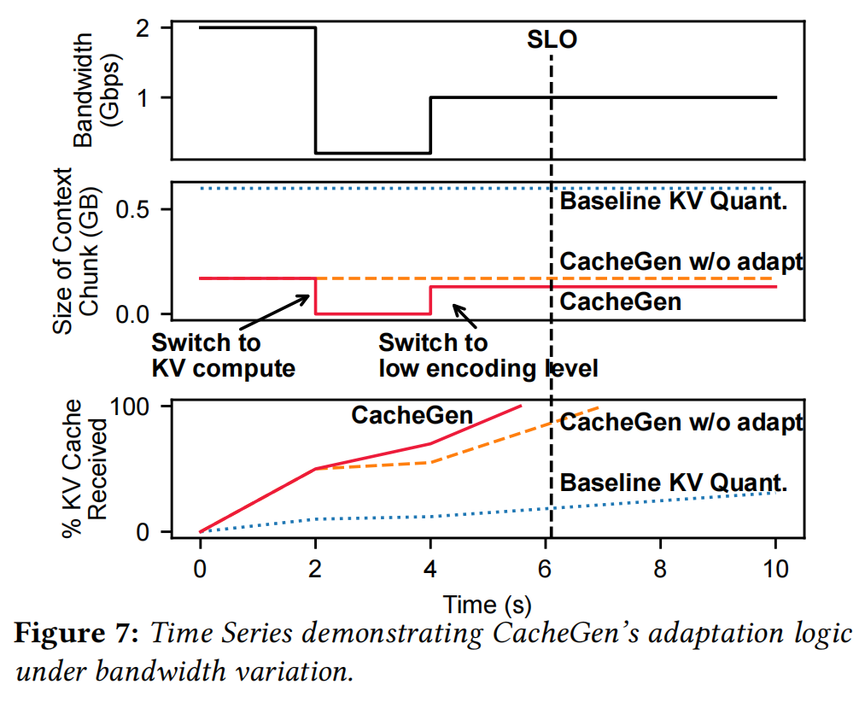
CacheGen

Slide 6
CacheGen

Slide 7
CacheGen

